Slide 1
Learning by Exploration
Qingyun Wu, Huazheng Wang, Hongning Wang
Department of Computer Science
University of Virginia

Slide 2
Outline of this tutorial
Motivation
Classical exploration strategies
Efficient exploration in complicated real-world environments
Exploration in non-stationary environments
Ethical considerations of exploration
Conclusion & future directions

Slide 3
Ethical considerations of exploration
Privacy concerns in bandits
Background: differential privacy (for continual release)
Differential private stochastic and linear bandits
Locally differential private bandits
Fairness concerns in bandits
Weakly meritocratic fairness
FairUCB

Slide 4
Ethical considerations of exploration
Privacy concerns in bandits
Background: differential privacy (for continual release)
Differential private stochastic and linear bandits
Locally differential private bandits
Fairness concerns in bandits
Weakly meritocratic fairness
FairUCB
Safety concerns in bandits: exploration with constraints
Regret constraint: conservative exploration [WSLS16, KGYR17]
Side constraint: [AAT19, KB20]
Will not cover the details due to time limit

Slide 5
Privacy concerns
“A Face Is Exposed for AOL Searcher No. 4417749” [BZH06]
“Robust De-anonymization of Large Datasets (How to Break Anonymity of the Netflix Prize Dataset)” [NS08]
In bandit setting: privacy for reward (and context) under extraction attacks
Philosophy: exploration reconciles the need for learning and the need for privacy protection

Slide 6
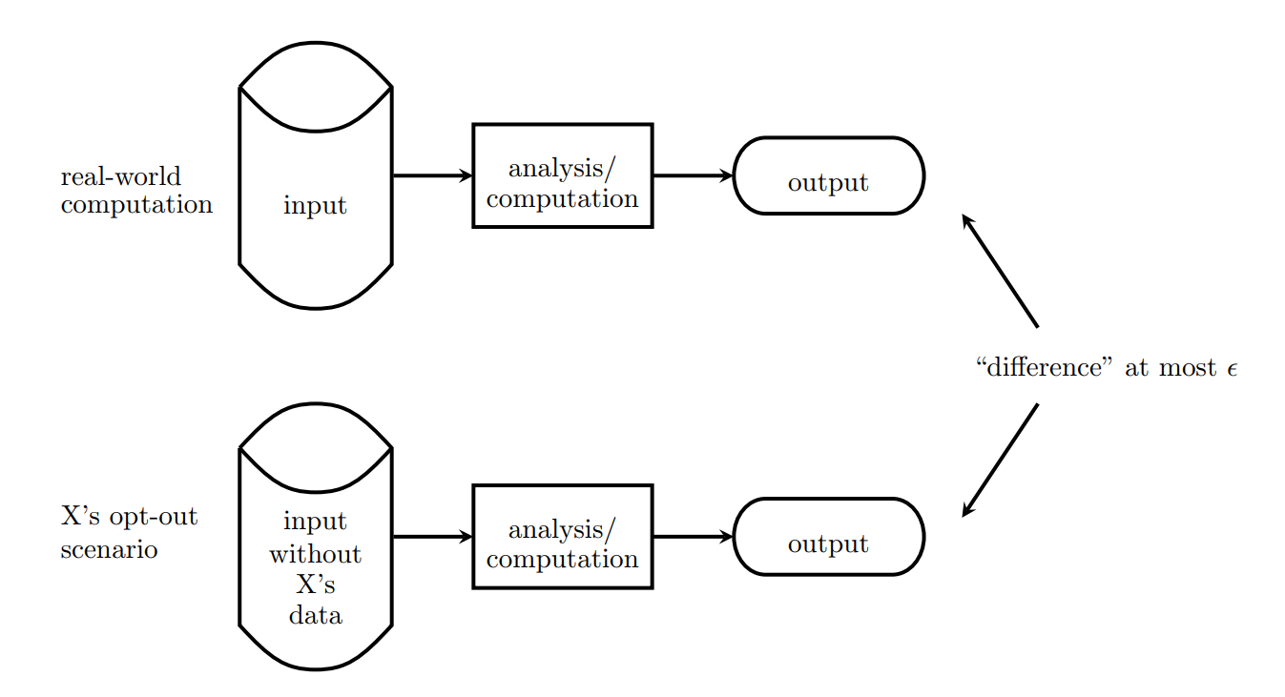
Differential privacy [Dwo06]
A randomized mechanism $A:X→Y$ is $(ε,δ)$-differentially private if for all neighboring inputs $X′$ and for all sets of outputs $O⊆Y$,
$$P\left(A\left(X\right)∈O\right)≤e^{ε}P\left(A\left(X^{′}\right)∈O\right)+δ$$
$δ=0$: $ε$-DP
Intuition: cannot differentiate whether a data point is presented
Figure from [Ngu19]

Slide 7
Differential privacy for continual observation
Data stream has T examples, $r_{i}∈[0, 1]$
Goal: Privately output the sum of first k data $α_{k}$, $k∈[1.. T]$
Aggregate k data by tree representation $a_{i}..b_{i}$
Output private statistics of $\sum{α_{a_{i}..b_{i}}}$
Reward $r_{i}$
Private output

Slide 8
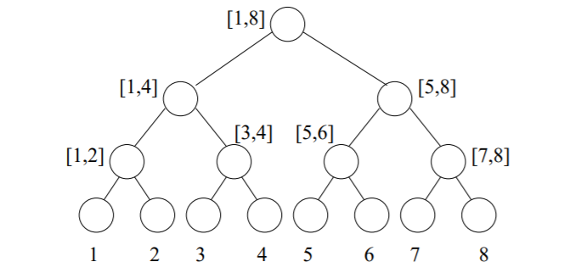
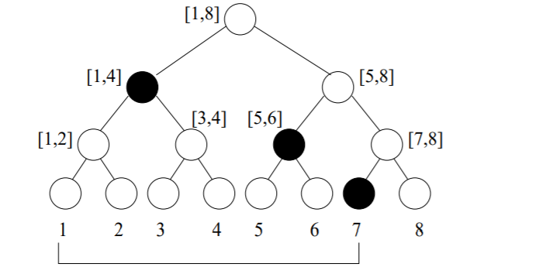
Tree-based aggregation [CSS10, DNPR10]
Represent sum of $r_{1}$to $r_{7}$ as $α_{1..4}+α_{5..6}+α_{7}$
Separate into $logT$ partial sums
Every node is a private partial sum with noise $Lap\left(\frac{logT}{ε}\right)$: $\frac{ε}{logT}$-DP
By composition theorem the total sum is $ε$-DP
Noise (error) in private sum is bounded by $O(\log^{1.5}T /ε)$
Sum of $r_{1}$ to $r_{4}$ with $Lap\left(\frac{logT}{ε}\right)$

Slide 9
Differentially private UCB1 [MT15]
Idea: keep the averaged reward ${\hat{r}}_{a_{t}}=\frac{1}{N_{a_{t}}}∑r_{N_{a_{t}}}^{a_{t}}$ private
Post-processing invariant
Use tree based aggregation, add noise to $∑r_{N_{a_{t}}}^{a_{t}}$
Arm selection strategy: $argmax{ \hat{r}}_{a_{t}}^{private}+CB\left(a_{t}\right)+O(\frac{\log^{1.5}N_{a_{t}}}{ε})$
Additional confidence term for exploration in private setting
Regret: $O(\frac{k\log^{2}T}{εΔ})$.
Reward $r_{i}$
Private recommendation

Slide 10
Differentially private LinUCB
Privacy for reward [NR18]
Use tree based aggregation, add noise to $b_{t}$
Arm selection strategy: $argmax {\hat{r}}_{a_{t}}^{private}+CB\left(a_{t}\right)+O(\frac{\log^{1.5}N_{a_{t}}log\frac{K}{δ} }{ε})$
Regret: $O(K\sqrt{T}\log{T}+\frac{\log^{2.5}T\sqrt{T} }{ε})$
Closed form estimator of LinUCB

Slide 11
Differentially private LinUCB
Privacy for both context and reward [SS18]
Use tree based aggregation, add noise to $A_{t}^{}$ and $b_{t}$
Arm selection strategy: $argmax {\hat{r}}_{a_{t}}^{private}+CB_{private}\left(a_{t}\right)$
Regret: $O(\frac{\log{T} }{Δ}+\frac{\log{T}\sqrt{(d\log{\frac{1}{δ})/ε}} }{Δ})$
Also showed a matched gap-dependent lower bound
Constructing the lower bound based on definition of privacy for context
Closed form estimator of LinUCB

Slide 12
Local differential privacy
DP: user sent data to center, center add noise to the aggregated result
Concerns: Data communication or even the center can be compromised
LDP: Data is randomized on the user side before sent to aggregator
LDP is a stronger privacy definition
Larger cost / regret is expected
Private reward $r_{i}$
Private recommendation
Reward $r_{i}$

Slide 13
UCB with local differential privacy
LDP-UCB-Laplace [RZLS20]
User sends noisy feedback $r_{t}+Lap(\frac{1}{ε})$ to the server
Arm selection strategy: $argmax {{\hat{r}}_{a}}_{t}+CB\left(a_{t}\right)+\sqrt{\frac{32\log{t}}{ε^{2}N_{a_{t}}}}$
Additional confidence term for exploration in private setting
Regret: $O(\frac{k\log{T}}{ε^{2}Δ})$.

Slide 14
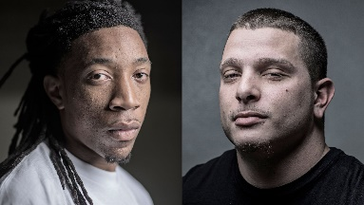
Fairness concerns
Machine Bias – an important topic
Research of bias in data , model, algorithm etc.
E.g., discriminatory treatment of subpopulations
The need to explore
Fairness guarantee during online decision making (bandits)

Slide 15
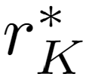
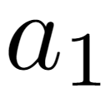
Weakly meritocratic fairness [JKMNR16]
Fairness definition: if reward $r_{a}^{∗}≥r_{b}^{∗}$ then $\operatorname{Pr}\left(pull a\right)≥Pr⁡(pull b)$
A fair bandits should never favor a worse arm at any round
Prefect strategy is fair: $\operatorname{Pr}\left(pull a^{∗}\right)=1$ -- but we don’t which arm is perfect at the beginning
Uniformly random is fair: $\operatorname{Pr}\left(pull a\right)=\frac{1}{K} ∀a$ -- Linear regret
Somewhere in between?
Reward
…

Slide 16
FairUCB [JKMR16]
Idea: uniformly pull arm within the first confidence interval chain
Start from the largest UCB, find overlapped confidence intervals
Guaranteed fairness at every step with high probability
Regret:
Reward
…

Slide 17
Open questions
Regret Lower Bound for bandits with privacy guarantee
What is the minimum noise and regret to achieve $ε$-DP/LDP?
Calibrate privacy and fairness with problem-dependent structure
Collaborative Bandits
Low-rank structure
Other fairness definition for exploration

Slide 18
References V
[BZH06] Barbaro, M., Zeller, T., & Hansell, S. (2006). A face is exposed for AOL searcher no. 4417749. New York Times, 9(2008), 8.
[NS08] Narayanan, A., & Shmatikov, V. (2008, May). Robust de-anonymization of large sparse datasets. In 2008 IEEE Symposium on Security and Privacy (sp 2008) (pp. 111-125). IEEE.
[Dwo06] Dwork, C. (2006, July). Differential privacy. In Proceedings of the 33rd international conference on Automata, Languages and Programming-Volume Part II (pp. 1-12). Springer-Verlag.
[Ngu19] Nguyen, A (2019). Understanding Differential Privacy.Towards Data Science. towardsdatascience.com/understanding-differential-privacy-85ce191e198a.
[CSS10] Chan, T. H., Shi, E., & Song, D. (2010, July). Private and continual release of statistics. In International Colloquium on Automata, Languages, and Programming (pp. 405-417). Springer, Berlin, Heidelberg.
[DNPR10] Dwork, C., Naor, M., Pitassi, T., & Rothblum, G. N. (2010, June). Differential privacy under continual observation. In Proceedings of the forty-second ACM symposium on Theory of computing (pp. 715-724).
[MT15] Mishra, N., & Thakurta, A. (2015, July). (Nearly) optimal differentially private stochastic multi-arm bandits. In Proceedings of the Thirty-First Conference on Uncertainty in Artificial Intelligence (pp. 592-601).
[TD16] Tossou, A. C., & Dimitrakakis, C. (2016, March). Algorithms for differentially private multi-armed bandits. In Thirtieth AAAI Conference on Artificial Intelligence.
[SS18] Shariff, R., & Sheffet, O. (2018). Differentially private contextual linear bandits. In Advances in Neural Information Processing Systems (pp. 4296-4306).

Slide 19
References VI
[NR18] Neel, S., & Roth, A. (2018, July). Mitigating Bias in Adaptive Data Gathering via Differential Privacy. In International Conference on Machine Learning (pp. 3720-3729).
[RZLS20] Ren, W., Zhou, X., Liu, J., & Shroff, N. B. (2020). Multi-Armed Bandits with Local Differential Privacy. arXiv preprint arXiv:2007.03121.
[JKMR16] Joseph, M., Kearns, M., Morgenstern, J. H., & Roth, A. (2016). Fairness in learning: Classic and contextual bandits. In Advances in Neural Information Processing Systems (pp. 325-333).
[JKMNR16] Joseph, M., Kearns, M., Morgenstern, J., Neel, S., & Roth, A. (2016). Fair algorithms for infinite and contextual bandits. arXiv preprint arXiv:1610.09559.
[WSLS16] Wu, Y., Shariff, R., Lattimore, T., & Szepesvári, C. (2016, June). Conservative bandits. In International Conference on Machine Learning (pp. 1254-1262).
[KGYR17] Kazerouni, A., Ghavamzadeh, M., Yadkori, Y. A., & Van Roy, B. (2017). Conservative contextual linear bandits. In Advances in Neural Information Processing Systems (pp. 3910-3919).
[AAT19] Amani, S., Alizadeh, M., & Thrampoulidis, C. (2019). Linear stochastic bandits under safety constraints. In Advances in Neural Information Processing Systems (pp. 9256-9266).
[KB20] Khezeli, K., & Bitar, E. (2020). Safe Linear Stochastic Bandits. In AAAI (pp. 10202-10209).

Slide 20
Outline of this tutorial
Motivation
Classical exploration strategies
Efficient exploration in complicated real-world environments
Exploration in non-stationary environments
Ethical considerations of exploration
Conclusion & future directions

Slide 21
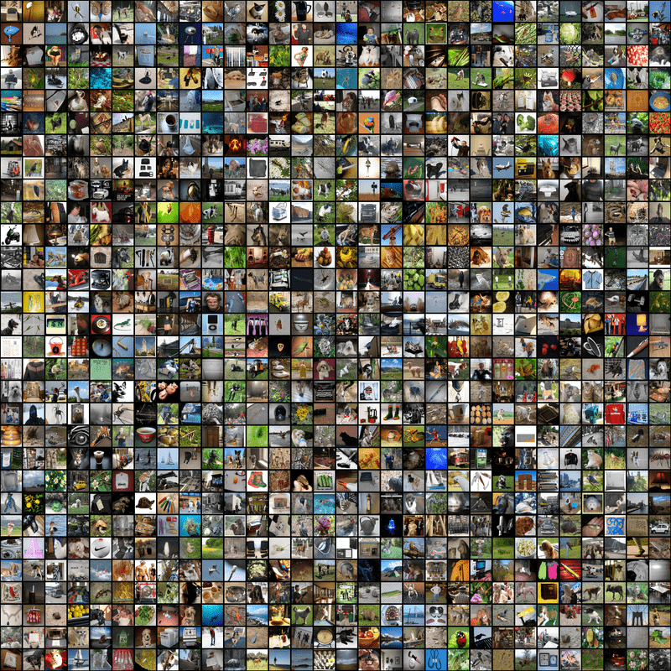
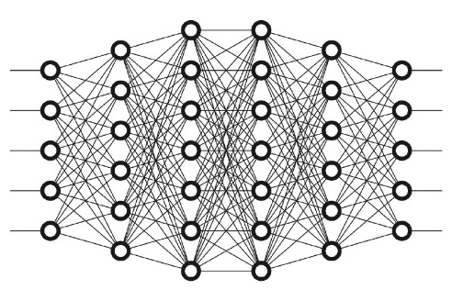
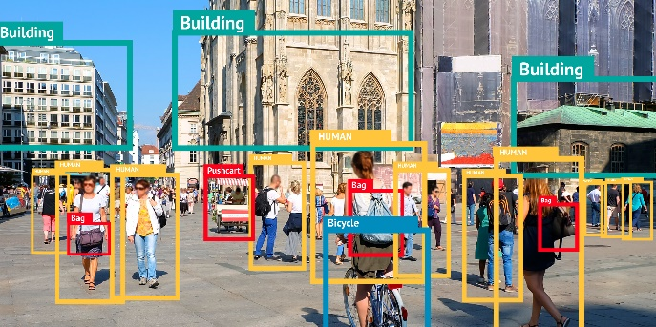
Conclusions
Learning by exploration
Efficiency matters
Accuracy matters
Training
Inference
Exploration matters
Knowing what we do not know

Slide 22
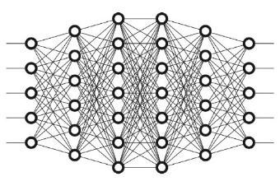
Future research directions
Going beyond linear models
How about deep models?
Reward
Action
Convergence matters!
Exploration matters!
Some preliminary studies exist: [ZLG19, AFB14]

Slide 23
Future research directions
Online deployment
Policy update driven by every interaction in real-time
Reward
Action
Convergence matters!
Exploration matters!
Some recent work: [WHCW19, KSL16, MWLS20]

Slide 24
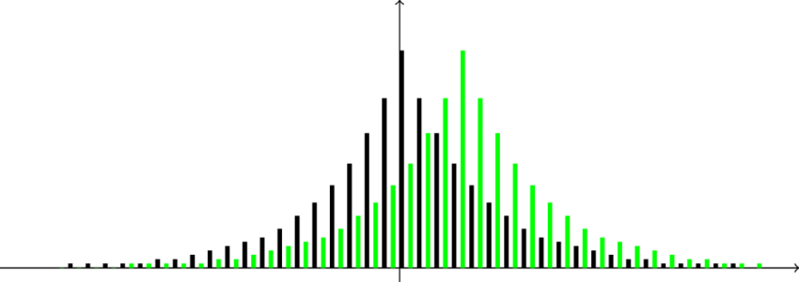
Future research directions
Learning under adversarial contexts
Privacy breach under extraction attacks
Exploration reconciles the need for learning and the need for privacy protection
[CKNFS11, Kor10]

Slide 25
Future research directions
Learning under adversarial contexts
Robustness under poisoning attacks
Action
Action
Feedback
Feedback
Action
Feedback
Randomness in exploration hardens the model against adversary; dependence structure among users improves privacy utility trade-off.

Slide 26
Future research directions
Incentivize the exploration
No regret under information gap
Latent factors
Semantic features
{Romance, Cameron}
Explanations?
{Drama, Damon}
{Drama, Korean}

Slide 27
References VII
[ZLG19] Zhou, D., Li, L., & Gu, Q. (2019). Neural Contextual Bandits with Upper Confidence Bound-Based Exploration. arXiv preprint arXiv:1911.04462.
[AFB14] Allesiardo, R., Féraud, R., & Bouneffouf, D. (2014, November). A neural networks committee for the contextual bandit problem. In International Conference on Neural Information Processing (pp. 374-381). Springer, Cham.
[WHCW19] Wang, Y., Hu, J., Chen, X., & Wang, L. (2019). Distributed bandit learning: Near-optimal regret with efficient communication. arXiv preprint arXiv:1904.06309.
[KSL16] Korda, N., Szorenyi, B., & Li, S. (2016, June). Distributed clustering of linear bandits in peer to peer networks. In International Conference on Machine Learning (pp. 1301-1309).
[MWLS20] Mahadik, K., Wu, Q., Li, S., & Sabne, A. (2020, June). Fast distributed bandits for online recommendation systems. In Proceedings of the 34th ACM International Conference on Supercomputing (pp. 1-13).
[CKNFS11] Calandrino, J. A., Kilzer, A., Narayanan, A., Felten, E. W., & Shmatikov, V. (2011, May). " You might also like:" Privacy risks of collaborative filtering. In 2011 IEEE symposium on security and privacy (pp. 231-246). IEEE.
[Kor10] Korolova, A. (2010, December). Privacy violations using microtargeted ads: A case study. In 2010 IEEE International Conference on Data Mining Workshops (pp. 474-482). IEEE.

Slide 28
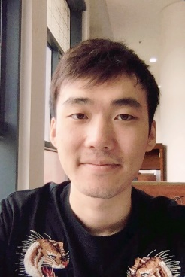
Acknowledgement
IIS-1553568
IIS-1618948

